Slide 1
Set-UID Privileged Programs

Slide 2
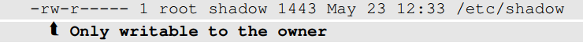
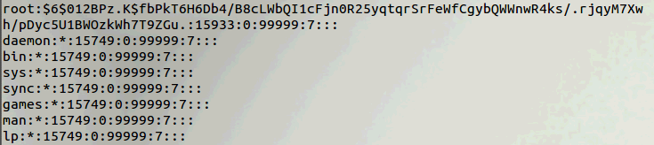
Need for Privileged Programs
Password Dilemma
Permissions of /etc/shadow file that stores password hashes (owner is root):
How can a non-root user change her password, if she cannot write to /etc/shadow file?
Notes:
Should be able to write to a particular section of a protected file , Example: Shadow File
Can be done using Privileged programs
Daemons
Set-UID Programs

Slide 3
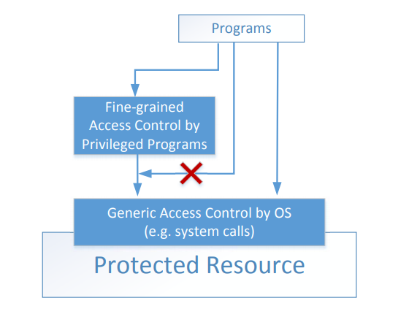
Two-Tier Approach
Implementing fine-grained access control in the OS makes OS over complicated.
Instead, OS relies on privileged programs to enforce fine-grained access control
Too complex

Slide 4
Types of Privileged Programs
Daemons
Computer program that runs in the background
Needs to run as root or other privileged users
Set-UID Programs
Widely used in UNIX systems
Program marked with a special bit

Slide 5

Superman Analogy
Superman (root user) wants to delegate superpower to a normal (non-root) user temporarily, by giving her a Power Suit that grants her the superpower for a specific task (e.g., setting her own password by modifying the /etc/shadow file), but the she cannot deviate from the specific task and do anything else.
Set-UID mechanism: A Power Suit mechanism implemented in Linux.
Notes:
Power Suit
Superpeople: Directly give them the power
Issues: bad superpeople
Power Suit 2.0
Computer chip
Specific task
No way to deviate from pre-programmed task

Slide 6
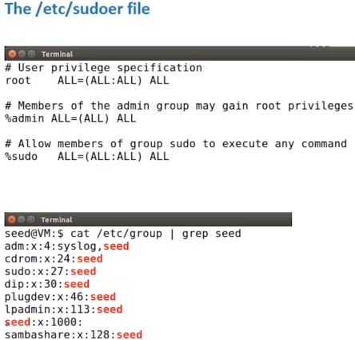
Why user “seed” can run sudo
/etc/sudoer specifies that sudo can execute any command
User “seed” is configured to be part of group “sudo”, hence you can run sudo when logged in as seed.

Slide 7
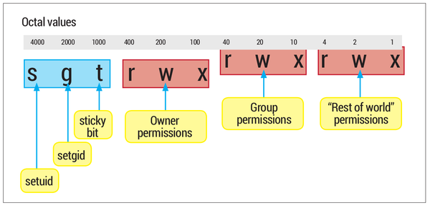
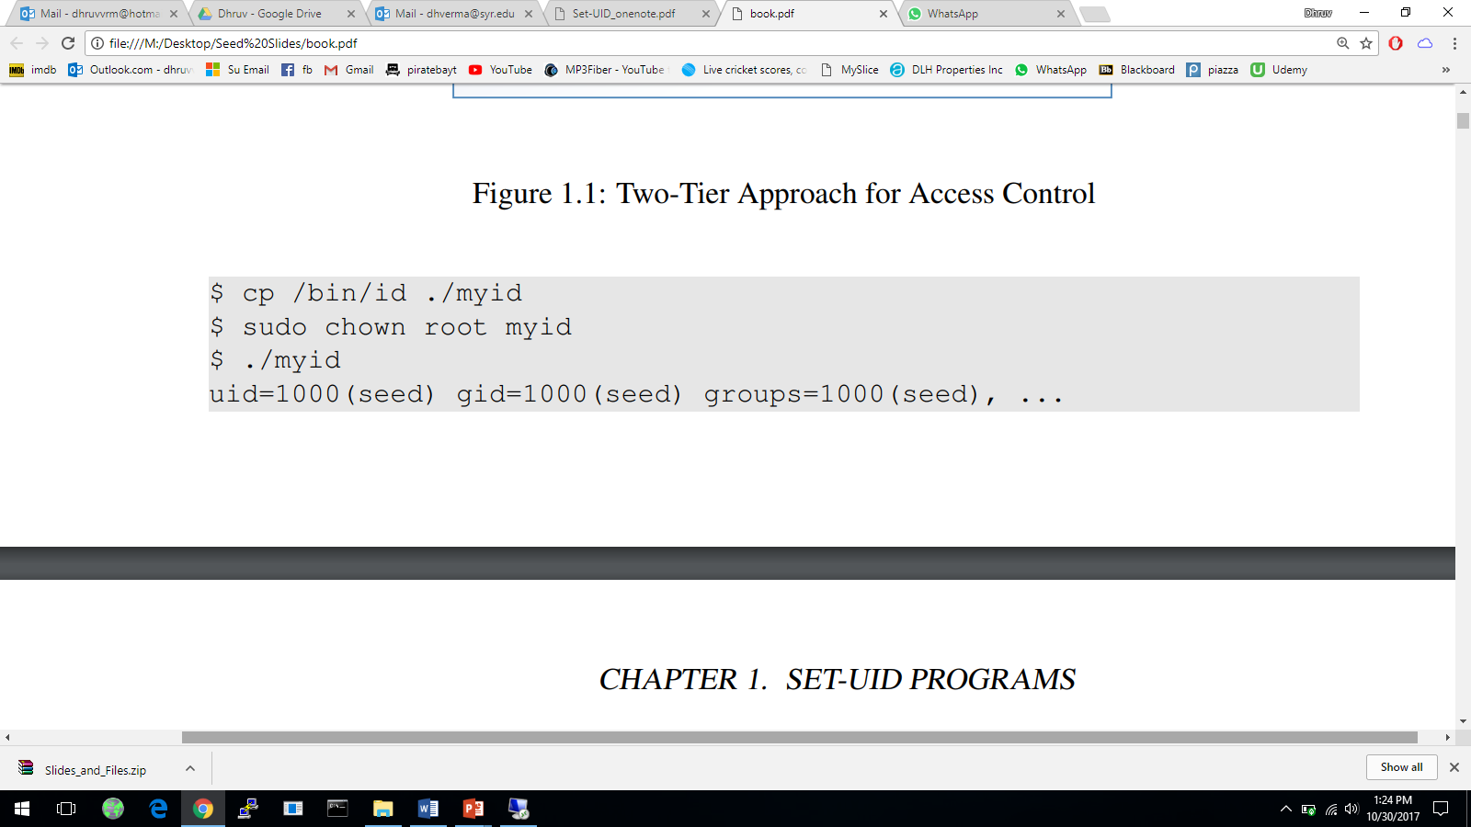
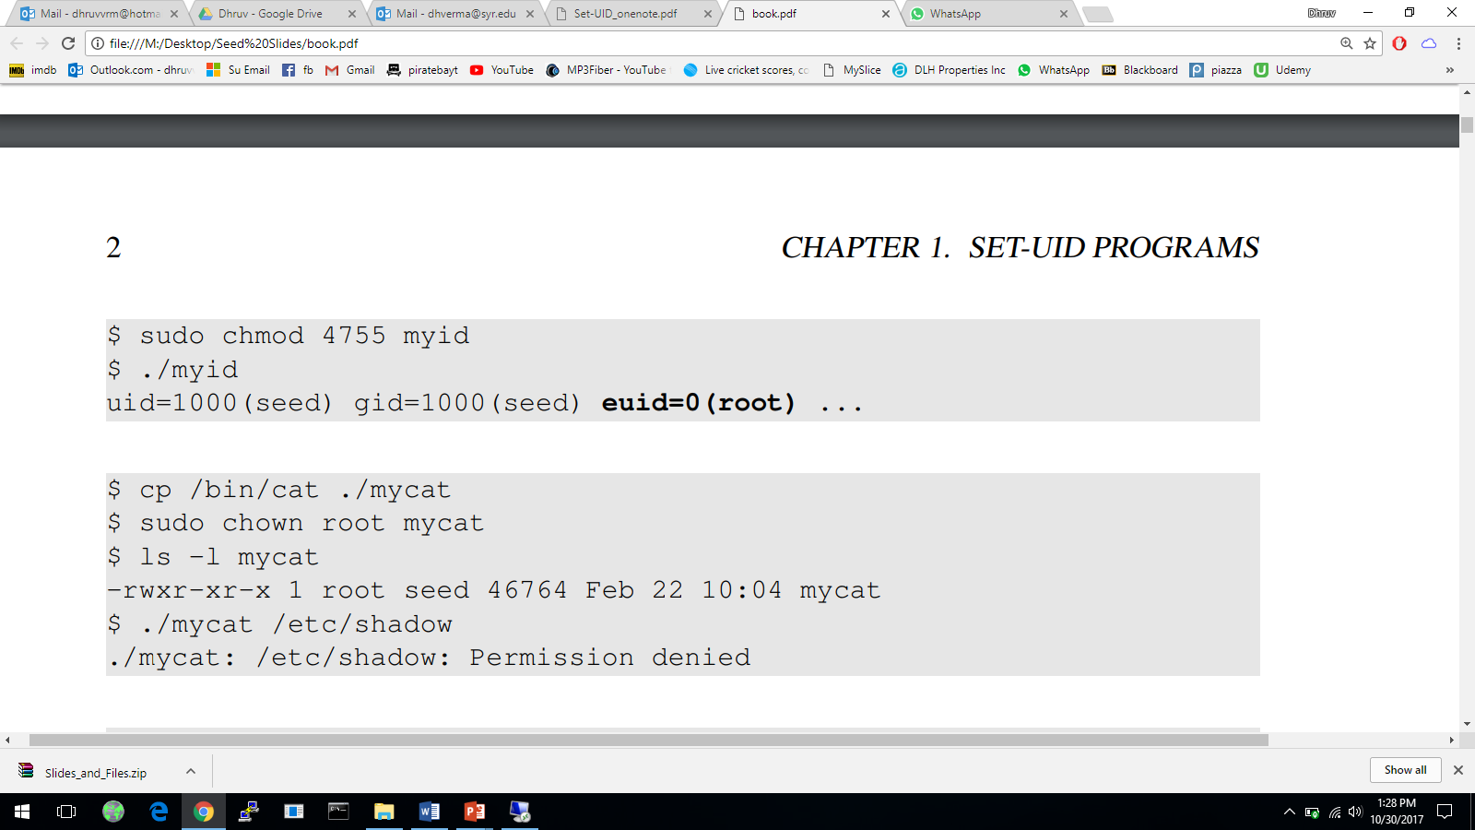
Set-UID Concept
Every process has two User IDs: Real UID (RUID): Identifies real owner of process; Effective UID (EUID): Identifies privileges of a process; access control is based on EUID
When a normal program is executed, RUID = EUID, both equal to the ID of the user who runs the program.
Command “chmod 4755” sets setuid=1 (4 corresponds to binary 100)
When a Set-UID program (with setuid=1) is executed, RUID ≠ EUID. RUID is still the user’s ID, but EUID is now the program owner’s ID. This allows the user to run the program with temporarily elevated privileges (root privileges if owner is root), in order to perform a specific task that requires root privileges
Notes:
Explanation of different types of user id
Relationship showing changes in RUID and EUID for user SEED when they run a program which is owned by themselves, by MARY and by ROOT.
A Set-UID program is just like any other program, except that it has Set-UID=1
If the owner is root, then the program runs with the root privilege.

Slide 8
Set-UID Example
The “passwd” program has root as its owner (EUID = root), and the bit setuid=1 (denoted as owner permission bits “rws”, using ‘s’ to replace ‘x’).
$ ls -l /usr/bin/passwd
-rwsr-xr-x 1 root root 41284 Sep 12 2012 /usr/bin/passwd
When a normal user executes the “passwd” program, it temporarily assumes root privileges (EUID = root) during execution of “passwd”, so she can change her own password by modifying /etc/shadow (or /etc/password) file. The “passwd” program checks the real user ID (RUID) and only allows change to RUID’s password (unless RUID = root)
“Set group ID”(setgid) is similar, but for group privileges instead of owner.
Notes:
Allow user to run a program with the program owner’s privilege.
Allow users to run programs with temporary elevated privileges
Example: the passwd program
Command “chmod 6711 passwd” sets both setuid and setgid bits for executable file “passwd”
6711 corresponds to binary 110 111 001 001. First 2 bits indicate that the bits setuid=1; setgid=1
$ ls -l /usr/bin/passwd
-rwsr-xr-x 1 root root 41284 Sep 12 2012 /usr/bin/passwd
To represent the setuid, setgid and sticky or text attributes, the executable character ('x' or '-') is modified. Though these attributes affect the overall file, not only users in one class, the setuid attribute modifies the executable character in the triad for the user, the setgid attribute modifies the executable character in the triad for the group and the sticky or text attribute modifies the executable character in the triad for others. For the setuid or setgid attributes, in the first or second triad, the 'x' becomes 's' and the '-' becomes 'S'. For the sticky or text attribute, in the third triad, the 'x' becomes 't' and the '-' becomes 'T'. Here is an example:
-rwsr-Sr-t: a file whose user class has read, write and execute permissions; whose group class has read permission; whose others class has read and execute permissions; and which has setuid, setgid and sticky attributes set.
https://en.wikipedia.org/wiki/File_system_permissions
They are the first two bits in the 3 bits preceding the 9 permission bits
The remaining three bits define special additional behavior for files or directories.
Two of these are the “set user ID” (Set-UID) and “set group ID” (SetGID)
permissions. If these are set on an executable file, the operating system functions as
follows. When a user (with execute privileges for this file) executes the file, the system
temporarily allocates the rights of the user’s ID of the file creator, or the file’s group,
respectively, to those of the user executing the file. These are known as the “effective
user ID” and “effective group ID” and are used in addition to the “real user ID” and
“real group ID” of the executing user when making access control decisions for this
program. This change is only effective while the program is being executed. This feature
enables the creation and use of privileged programs that may use files normally
inaccessible to other users. It enables users to access certain files in a controlled fashion.
Alternatively, when applied to a directory, the SetGID permission indicates that newly
created files will inherit the group of this directory. The Set-UID permission is ignored.
The final permission bit is the “Sticky” bit. When set on a file, this originally
indicated that the system should retain the file contents in memory following execution.
This is no longer used. When applied to a directory, though, it specifies that
only the owner of any file in the directory can rename, move, or delete that file. This
is useful for managing files in shared temporary directories.
One particular user ID is designated as “superuser.” The superuser is
exempt from the usual file access control constraints and has systemwide access.
Any program that is owned by, and Set-UID to, the “superuser” potentially grants
unrestricted access to the system to any user executing that program. Hence great
care is needed when writing such programs. If they are set on an executable program: when a user (with execute right for this file) executes the program, the system temporarily elevates the user’s access rights to the rights of the file creator (for Set-UID), or the file’s group (for SetGID), known as the “effective user ID”/“effective group ID”.
(if its owner is already root, then this command has no effect)

Slide 9
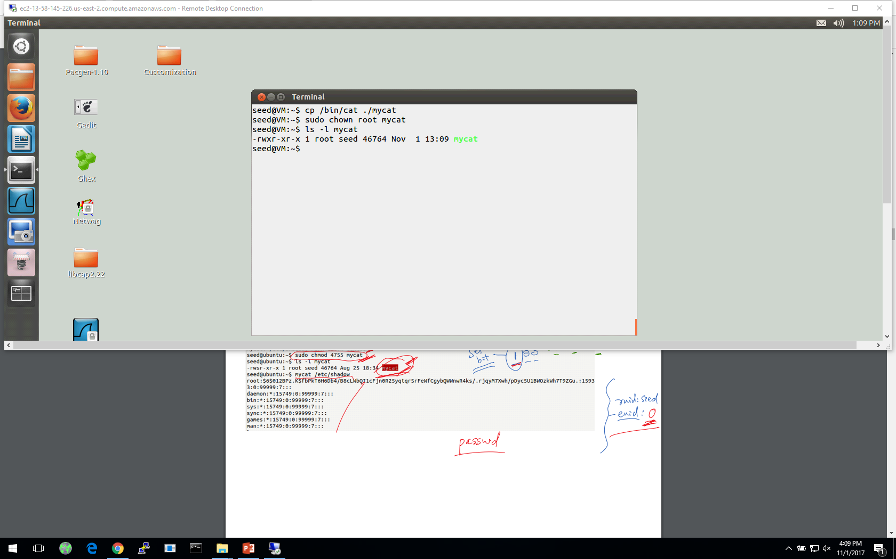
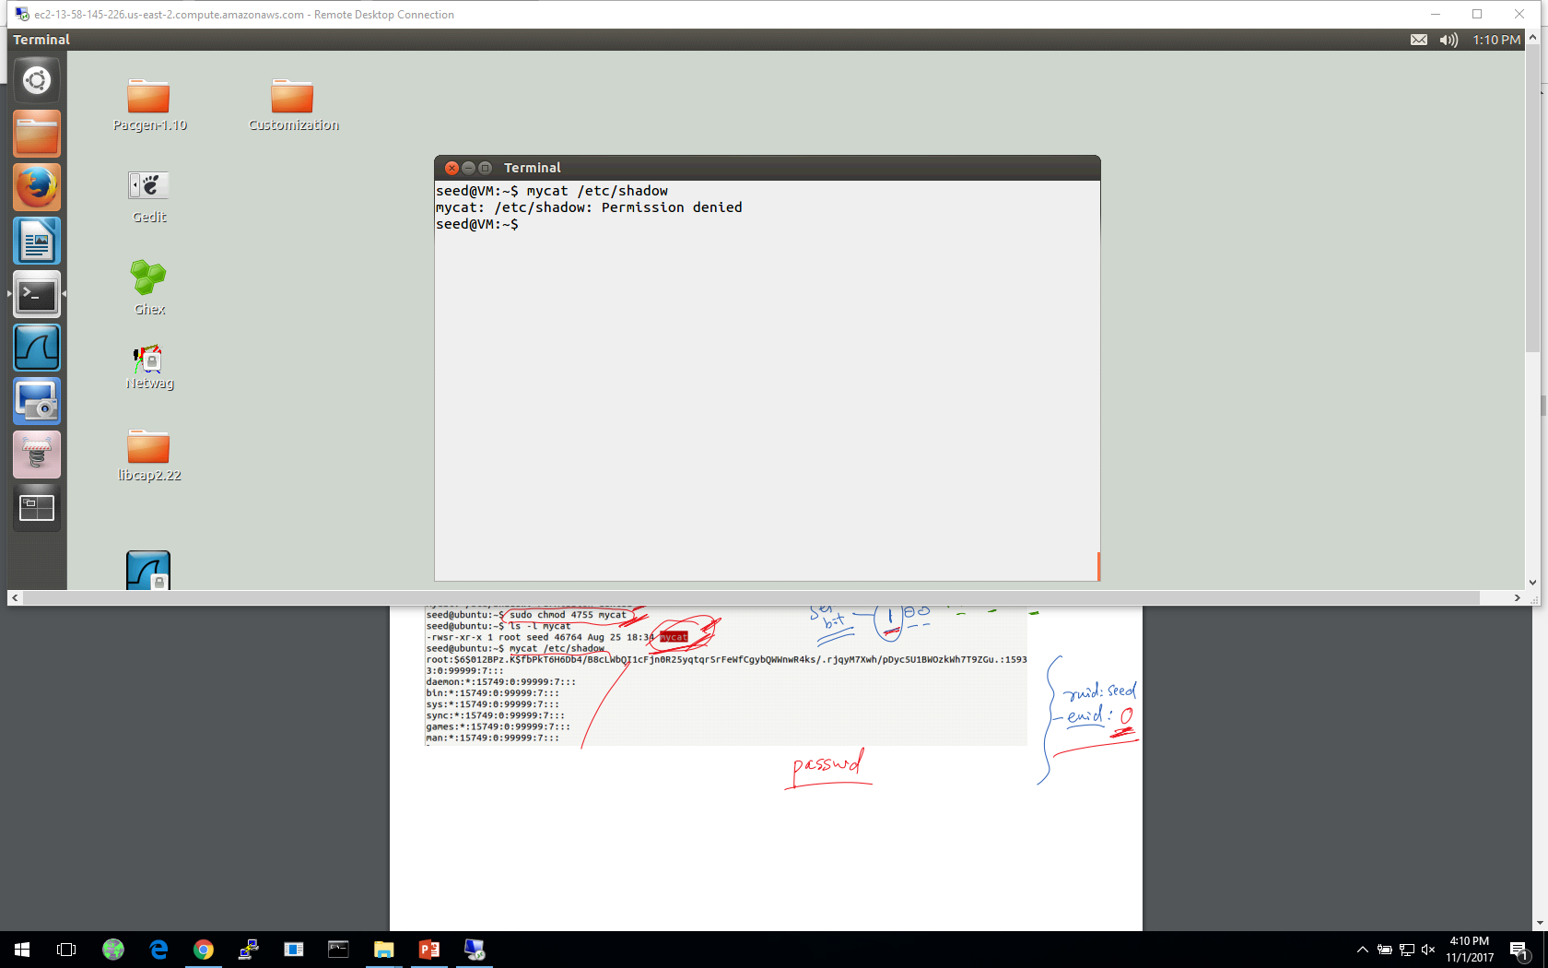
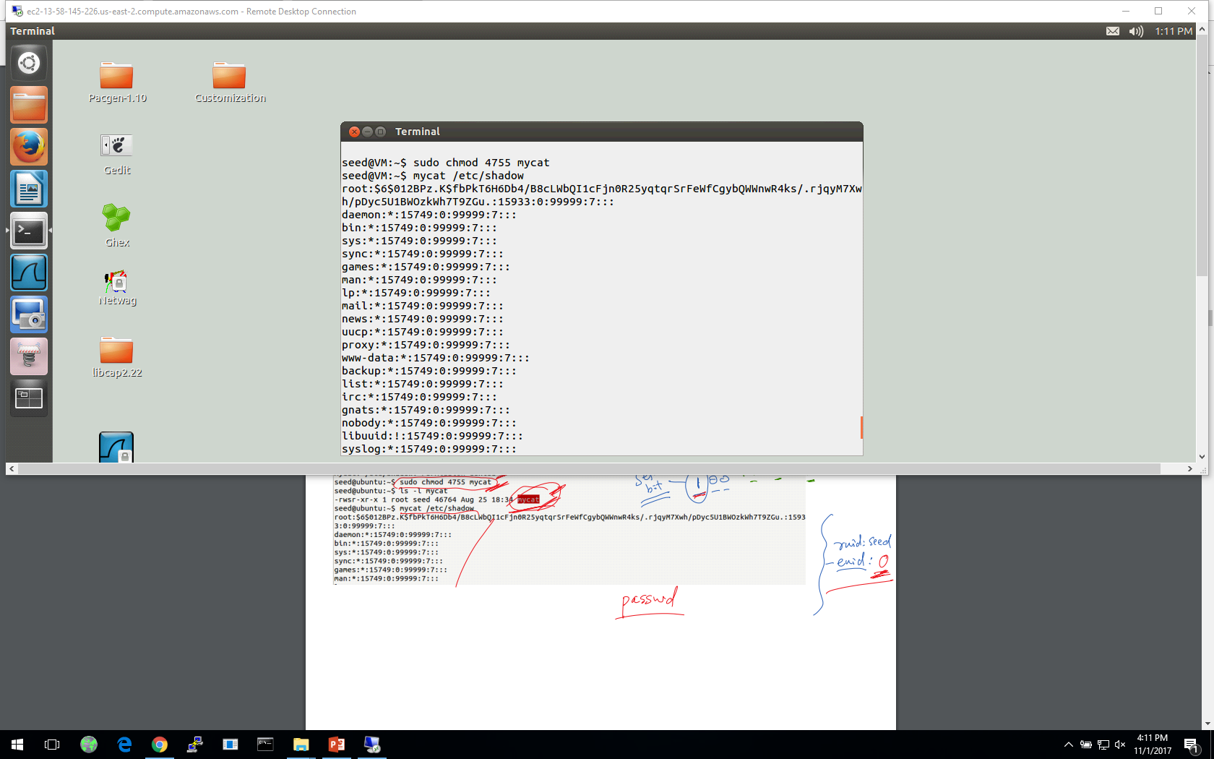
Turn a Program into a Set-UID Program
Change the owner of a file to root :
Before Enabling Set-UID bit:
After Enabling the Set-UID bit:
Notes:
Create a program which runs like cat and change its ownership to root
Try to cat the /etc/shadow file
Convert the program into Set-UID program
Now try to cat the /etc/shadow file

Slide 10
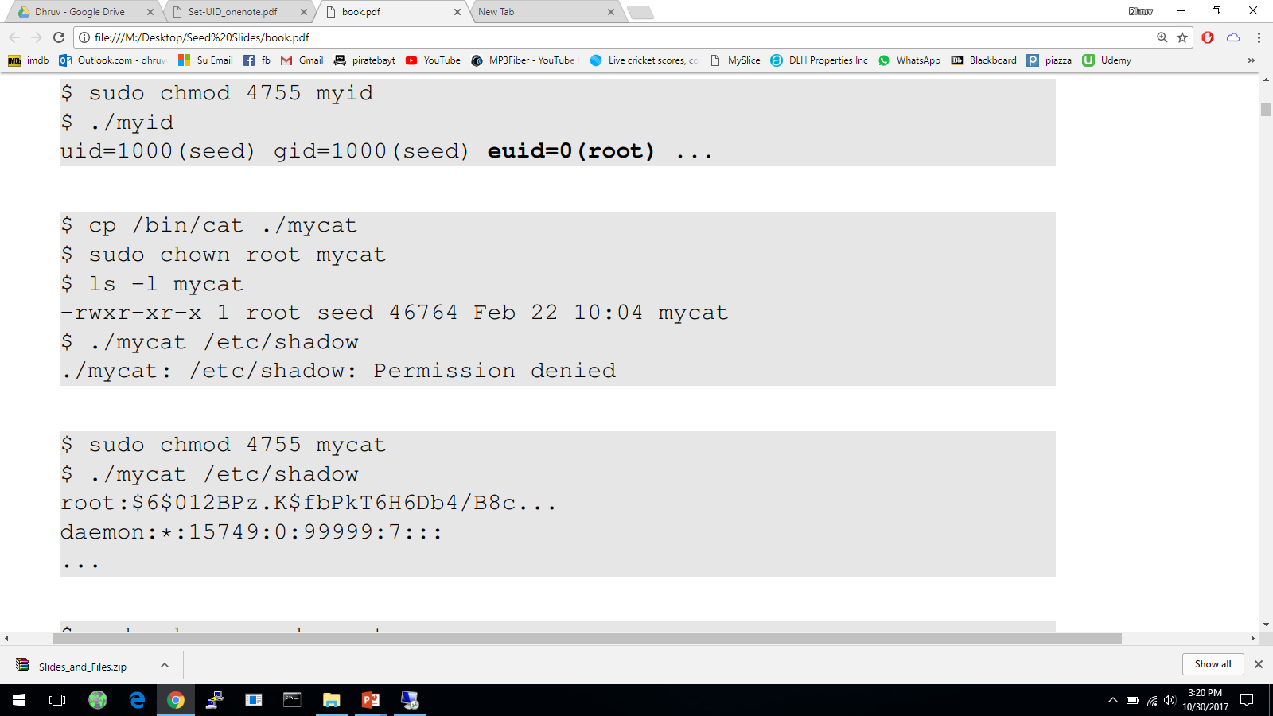
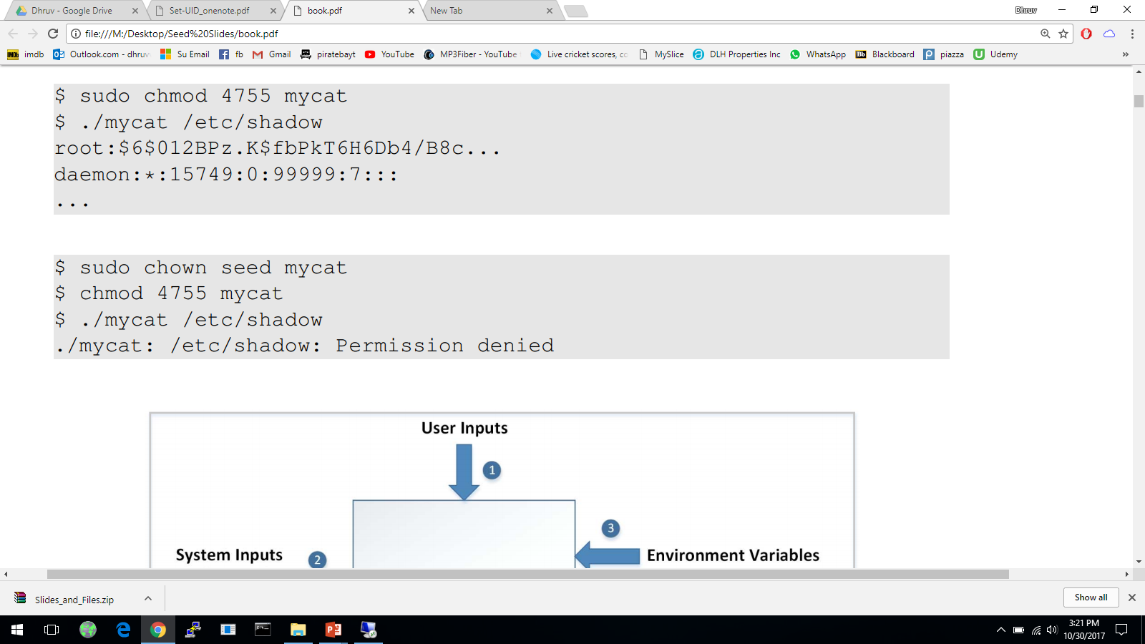

Example of Set UID
Note: must run chown before running “chmod 4755”, since chown always sets Set-UID=0 as a safeguard.
/bin/cat has owner root; Mycat has owner seed, the user who copied the file. “chown root mycat” changes owner to root; Set-UID is not set (owner permission bits rwx), so has no read access to /etc/shadow
“chmod 4755 mycat” sets Set-UID=1 (owner permission bits rws); has root privileges during execution, so has read access to /etc/shadow
“chown seed mycat” changes owner back to seed; chmod 4755 mycat sets Set-UID=1; has privileges of user seed during execution, so has no read access to /etc/shadow.

Slide 11
How is Set-UID Secure?
Allows normal users to escalate privileges
This is different from directly giving the privileges directly like command sudo
Restricted behavior – can only perform the specific task
Unsafe to turn all programs into Set-UID
Example: /bin/sh
Example: vi
Notes:
Difference between set-uid and sudo
Defining why set-uid is secure and relating it to superman story
What programs should not be turned into set-uid and why?

Slide 12
Set-UID Quiz
Q: Bob and you both have accounts on the same UNIX system. Bob has gone away for lunch and has forgot to lock his computer screen. Can you take over his account completely in the future, by starting a shell from your own login shell, but with user ID Bob?
A: Yes. Run these commands in Bob’s shell to turn mysh into a Set-UID program:
$cp /bin/sh /tmp/mysh
$chmod 4755 /tmp/mysh
Later, from your own login shell, run
$/tmp/mysh
mysh has RUID as my user ID, and EUID as Bob’s user ID, so it runs with privileges of Bob.

Slide 13
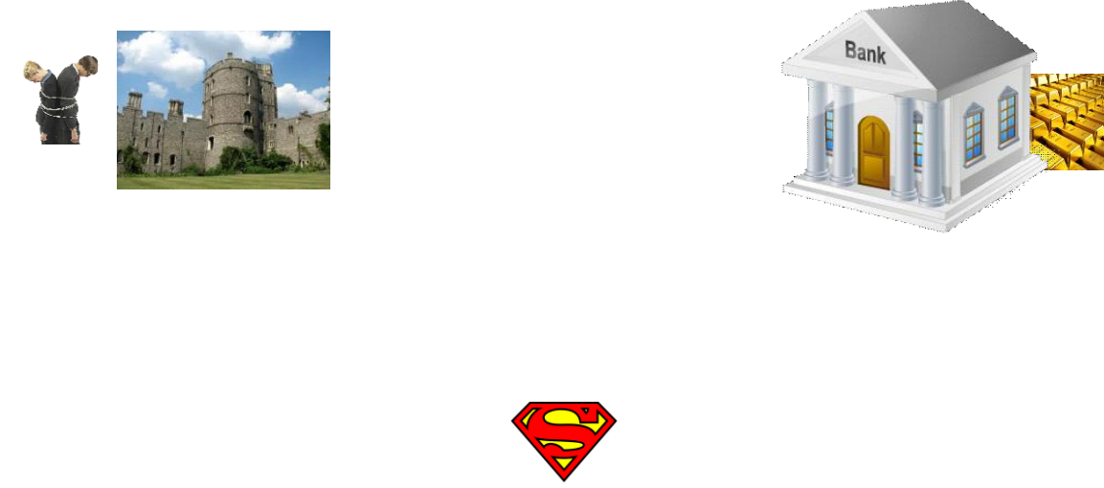
Attacks on Superman
Superman gives the Power Suit to a non-root user to turn her into a Superperson temporarily. Superperson is supposed to take path 1 to rescue hostages, but she is malicious and wants to take path 2 to rob a bank.
With instruction “Fly north then turn left”: he can fly face-up, so turning left goes to the bank
With instruction “Fly North and turn west”: he can put a strong magnet near the turning point to reverse the magnetic field, so he actually turns east and goes to the bank
1
2
Notes:
Talking about attacks on superman’s strategy and relating it to how hackers can try to attack any mechanism

Slide 14
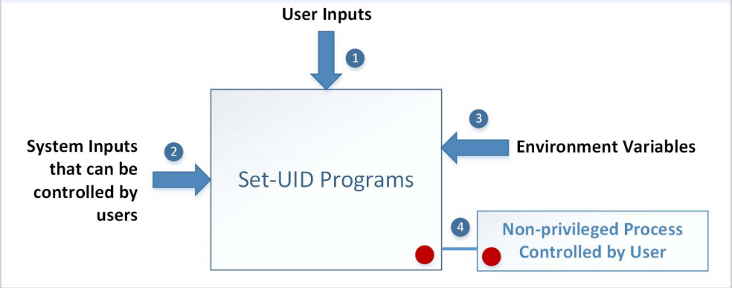
Attack Surfaces of Set-UID Programs
1. User inputs/External Programs
2. System inputs: race Conditions (e.g., with symbolic link to privileged file from an unprivileged file)
3. Environment variables
4. Non-privileged process controlled by user: capability leaking
Notes:
Influence programs
Writing inside world writable folder
System Inputs
Race Condition – More information in Chapter 7
Symbolic link to privileged file from a unprivileged file
Influence programs
Writing inside world writable folder
Carrying on from superman story, relate User inputs/External Programs: Explicit Inputs
Buffer Overflow – More information in Chapter 4
Overflowing a buffer to run malicious code
Format String Vulnerability – More information in Chapter 6
Changing program behavior using User inputs/External Programs as format strings
it to the attack surface on set-uid programs

Slide 15
Environment Variables
A set of dynamic named values
Part of the operating environment in which a process runs
Affect the way that a running process will behave
Introduced in Unix and also adopted by Microsoft Windows
Example: PATH variable
When a program is executed the shell process will use the environment variable to find where the program is, if the full path is not provided.
Notes:
Define what environment variables are

Slide 16
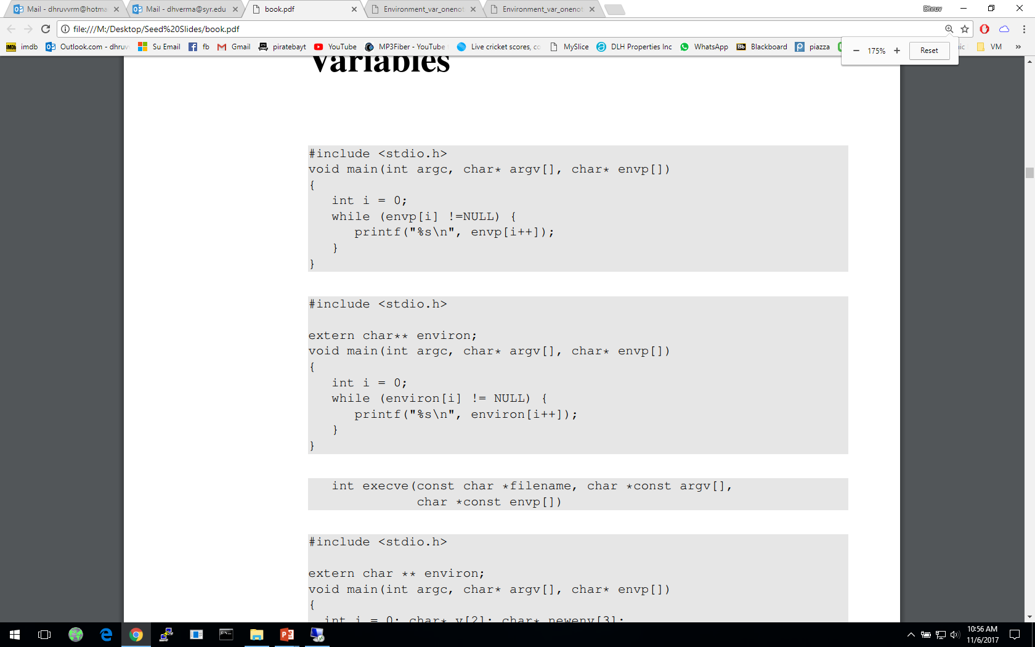
How to Access Environment Variables
From the main function
More reliable way:
Using the global variable
Notes:
Ways of accessing environment variables
envp[] and environ
Recommended approach is to use environ – reason explained in following slides

Slide 17
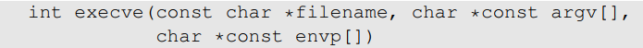
How Does a process get Environment Variables?
Process can get environment variables one of two ways:
If a new process is created using fork() system call, the child process will inherits its parent process’s environment variables.
If a process runs a new program in itself, it typically uses execve() system call. In this scenario, the memory space is overwritten and all old environment variables are lost. execve() can be invoked in a special manner to pass environment variables from one process to another.
Passing environment variables when invoking execve() :
Notes:
Getting environment variables
3rd argument in execve() system call

Slide 18
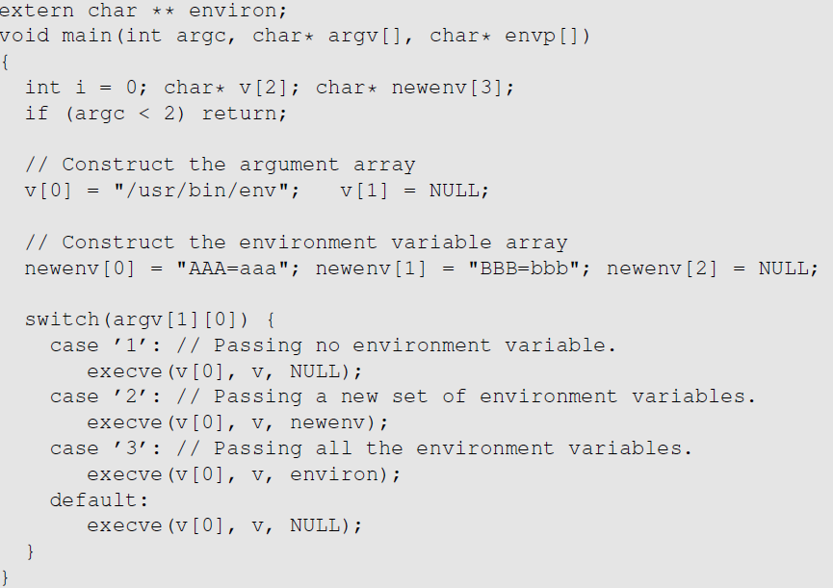
execve() and Environment variables
The program executes a new program /usr/bin/env, which prints out the environment variables of the current process.
We construct a new variable newenv, and use it as the 3rd argument.

Slide 19
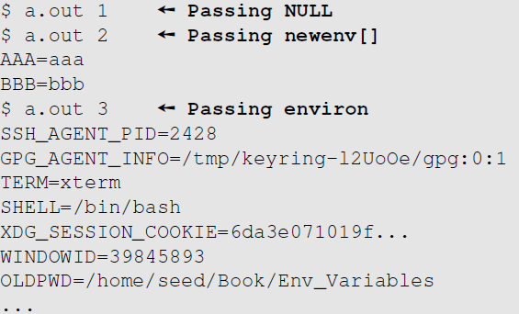
execve() and Environment variables
Obtained from the parent process
Notes:
Getting environment variables
3rd argument in execve() system call

Slide 20
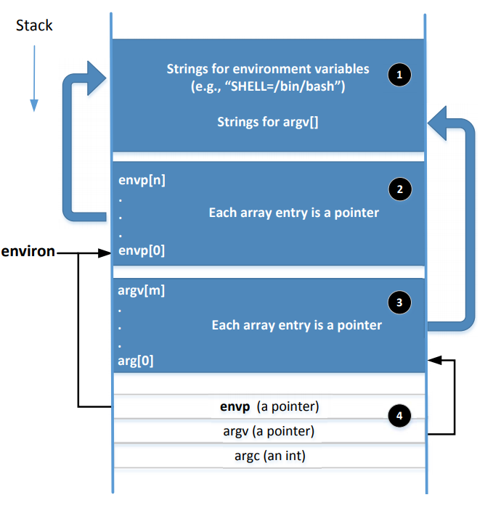
Memory Location for Environment Variables
envp and environ points to the same place initially.
envp is only accessible inside the main function, while environ is a global variable.
When changes are made to the environment variables (e.g., new ones are added), the location for storing the environment variables may be moved to the heap, so environ will change (envp does not change)
Notes:
Adding or deleting environment variables or modifying the value of existing one, there not be enough space in 1 & 2. In this case, the entire environment variable block may change to a different location (usually in the heap)
When this change happens, the environ variable should be changed accordingly
A program can change their environment variables using putenv(), setenv() etc

Slide 21
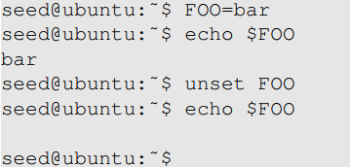
Shell Variables & Environment Variables
People often mistake shell variables and environment variables to be the same.
Shell Variables:
Internal variables used by shell.
Shell provides built-in commands to allow users to create, assign and delete shell variables.
In the example, we create a shell variable called FOO.

Slide 22
Side Note on The /proc File System
/proc is a virtual file system in linux. It contains a directory for each process, using the process ID as the name of the directory
Each process directory has a virtual file called environ, which contains the environment of the process.
e.g., virtual file /proc/932/environ contains the environment variable of process 932
The command “strings /proc/$$/environ” prints out the environment variable of the current process (shell will replace $$ with its own process ID)
When env program is invoked in a bash shell, it runs in a child process. Therefore, it print out the environment variables of the shell’s child process, not its own.

Slide 23
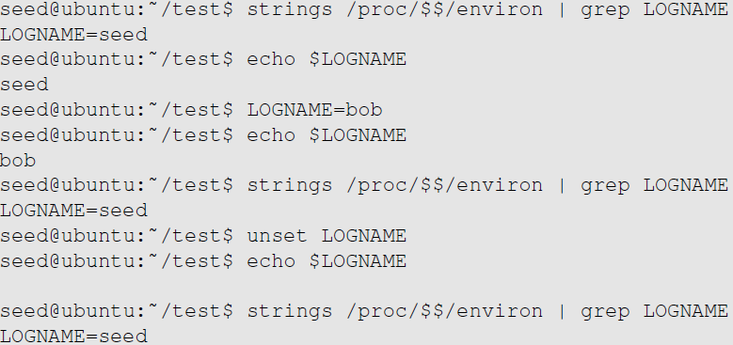
Shell Variables & Environment Variables
Shell variables and environment variables are different
When a shell program starts, it copies the environment variables into its own shell variables. Changes made to the shell variable will not reflect on the environment variables, as shown in example :
Environment variable
Shell variable
Shell variable is changed
Environment variable is the same
Shell variable is gone
Environment variable is still here
Notes:
Explain /proc/$$/environ: $$ will be replaced by the shell with the current process’s ID, so /proc/$$/environ basically contains the environment variables of the current process.

Slide 24
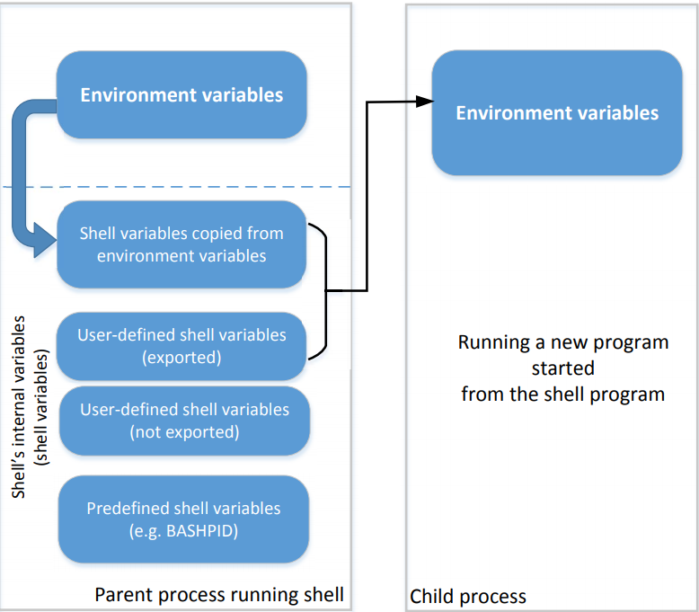
Shell Variables & Environment Variables
This figure shows how shell variables affect the environment variables of child processes
It also shows how the parent shell’s environment variables becomes the child process’s environment variables (via shell variables)
Notes:
How do shell variables become environment variables and why?
Fork()
Execve()
Which type of shell variables become the new environment variables?
Shell variables copied from environment variables
User defined shell variables using “export”
Example in next slide

Slide 25
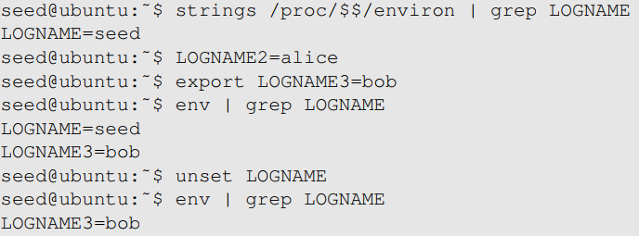
Shell Variables & Environment Variables
When we type env in shell prompt, shell will create a child process
Print out environment variable
Only LOGNAME and LOGNAME3 get into the child process, but not LOGNAME2. Why?
Notes:
Reason behind only LOGNAME and LOGNAME3 being printing
Unset function
How env is run as a child process is in next slide.

Slide 26
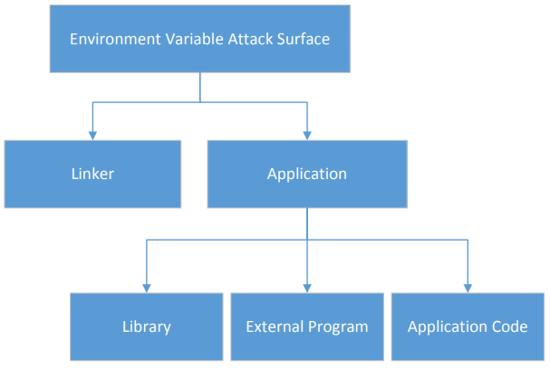
Attack Surface on Environment Variables
Hidden usage of environment variables is dangerous.
Since users can set environment variables, they become part of the attack surface on Set-UID programs.
Notes:
Overview of each of the parts and what they do
Linker
Library
External program
Application code

Slide 27
Task 6: The PATH Environment Variable and Set-UID Programs
Environment Variables: inherited from parent process, or set by this user that affects behavior of all programs run by this user.
PATH Environment Variable used by shell programs to locate a command if the user does not provide the full path for the command
The system(cmd) function executes "/bin/sh -c cmd“, and relies on the /bin/sh program to run cmd
system(“ls”)
/bin/sh uses the PATH environment variable to locate the executable file “ls”, which should be in /usr/bin/
Attacker can manipulate the PATH variable and control which “ls” command is run, e.g., “$ export PATH=/home/seed:$PATH” puts directory /home/seed before all other directories included in the original PATH, including /usr/bin. If attacker puts his own “ls” executable in the current directory, the command /home/seed/ls will be run with root privileges, instead of /usr/bin/ls.
Notes:
What are environment variables?
What are path environment variables?
How does System() work?
How can System(“ls”) be exploited?
Behavior can be influenced by inputs that are not visible inside a program.

Slide 28
IFS Attack
system(“/usr/bin/ls”), is it secure now?
Internal Field Separator (IFS) is an environment variable that can be set by the user to be “/”, so the original command becomes system(“ usr bin ls”), i.e. execute command “usr” with arguments “bin” and “ls”. Now attacker can create his own executable named “usr”, and run it with root privileges.
(No longer works in modern Linux.)

Slide 29
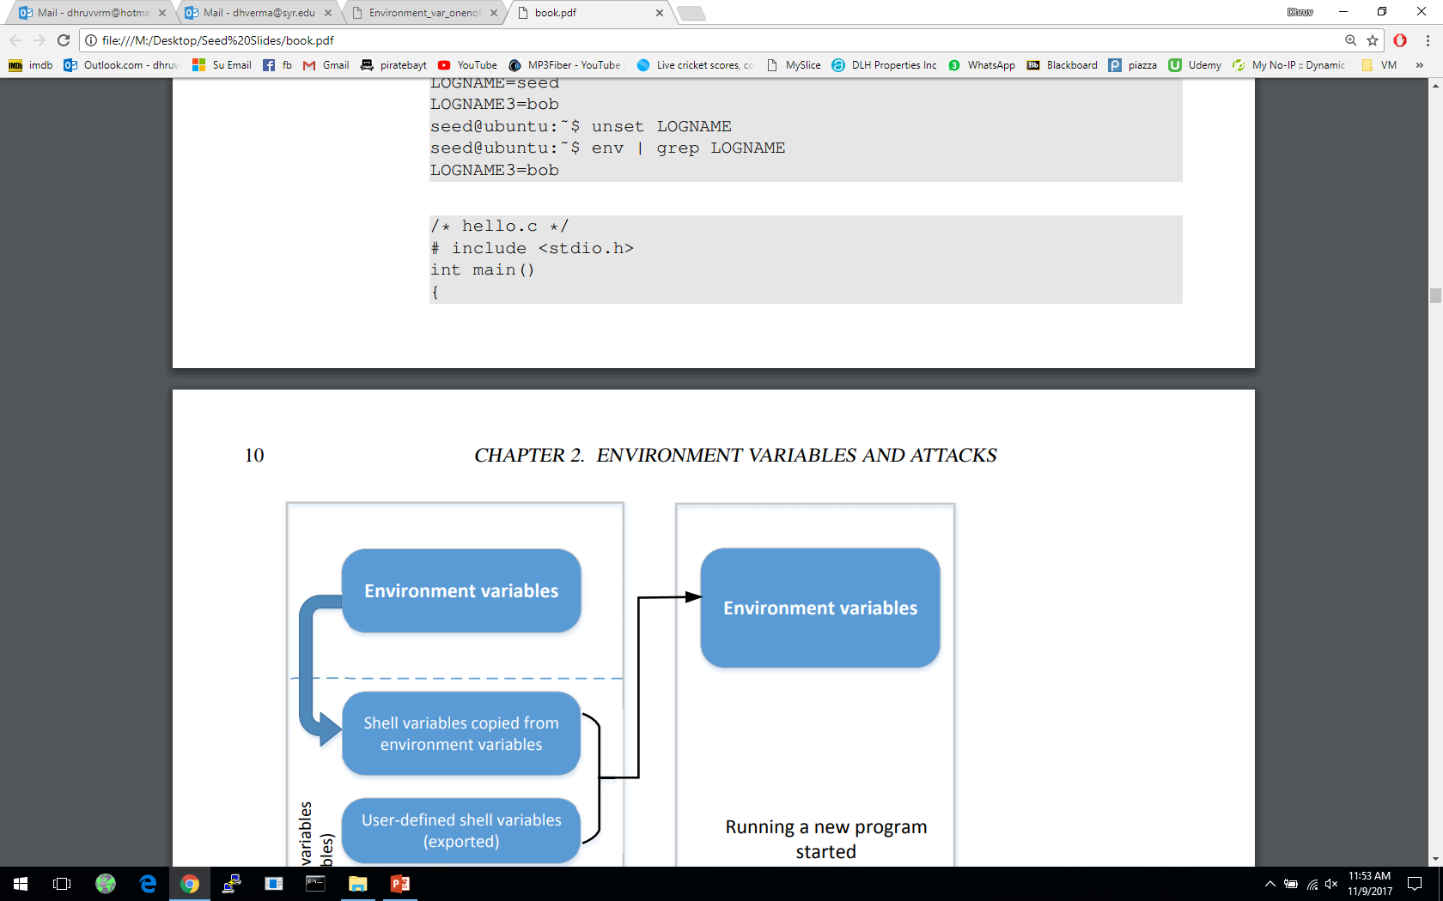
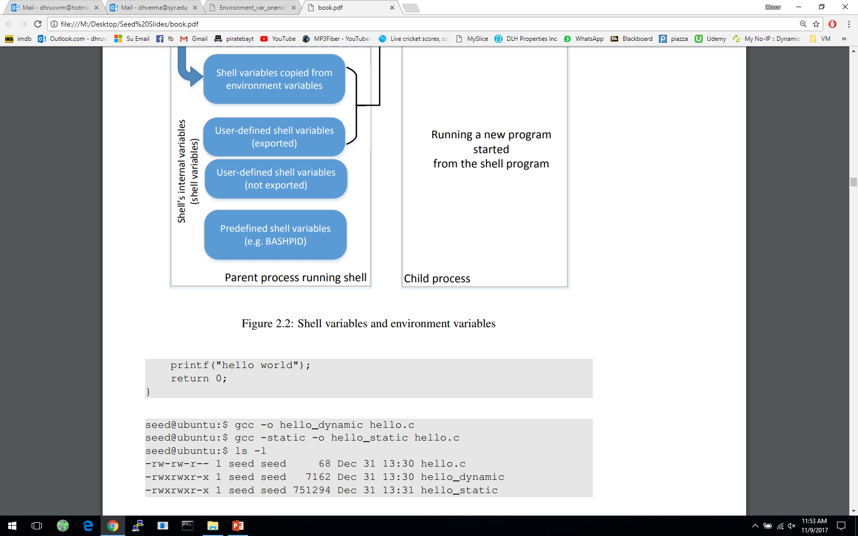
Attacks via Dynamic Linker
Linking finds the external library code referenced in the program
Linking can be done during runtime or compile time:
Dynamic Linking – uses environment variables, which becomes part of the attack surface
Static Linking
We will use the following example to differentiate static and dynamic linking:

Slide 30
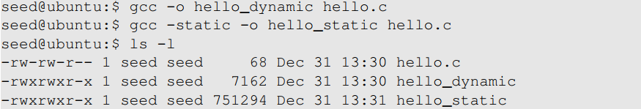
Attacks via Dynamic Linker
Static Linking
The linker combines the program’s code and the library code containing the printf() function
We can notice that the size of a static compiled program is 100 times larger than a dynamic program
Notes:
Static linking copies code and wastes a lot of memory
In time of a security path, everything will have to patched manually
Hence, dynamic linking is the recommended approach

Slide 31
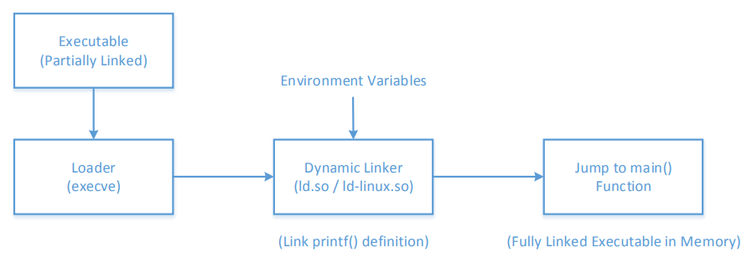
Attacks via Dynamic Linker
Dynamic Linking
The linking is done during runtime
Shared libraries (DLL in windows)
Before a program compiled with dynamic linking is run, its executable is loaded into the memory first
Notes:
What are shared libraries?
After loading into memory, loader passes control to dynamic linker
Linker finds implementation of printf() for shared libraries
Once linking is complete the control is given to main(0

Slide 32
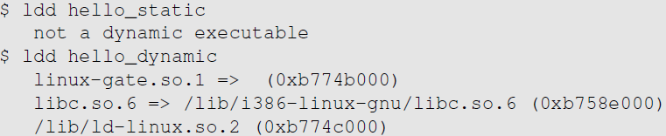
Attacks via Dynamic Linker
Dynamic Linking:
We can use “ldd” command to see what shared libraries a program depends on :
for system calls
The dynamic linker itself is in a shared library. It is invoked before the main function gets invoked.
The libc library (contains functions like printf() and sleep())

Slide 33
Attacks via Dynamic Linker: the Risk
Dynamic linking saves memory
This means that a part of the program’s code is undecided during the compilation time
If the user can influence the missing code, they can compromise the integrity of the program
Next, we discuss Task 7: The LD PRELOAD Environment Variable and Set-UID Programs.

Slide 34
Attacks via Dynamic Linker: Case Study 1
LD_PRELOAD specifies a list of additional, user-specified, shared libraries to be loaded before all others
If not all functions are found, the linker will search among several lists of folder including the one specified by LD_LIBRARY_PATH
Both variables can be set by users, so it gives them an opportunity to control the outcome of the linking process
If that program were a Set-UID program, it may lead to security breaches
Notes:
LD_PRELOAD contains a list of shared libraries which will be searched first by the linker

Slide 35
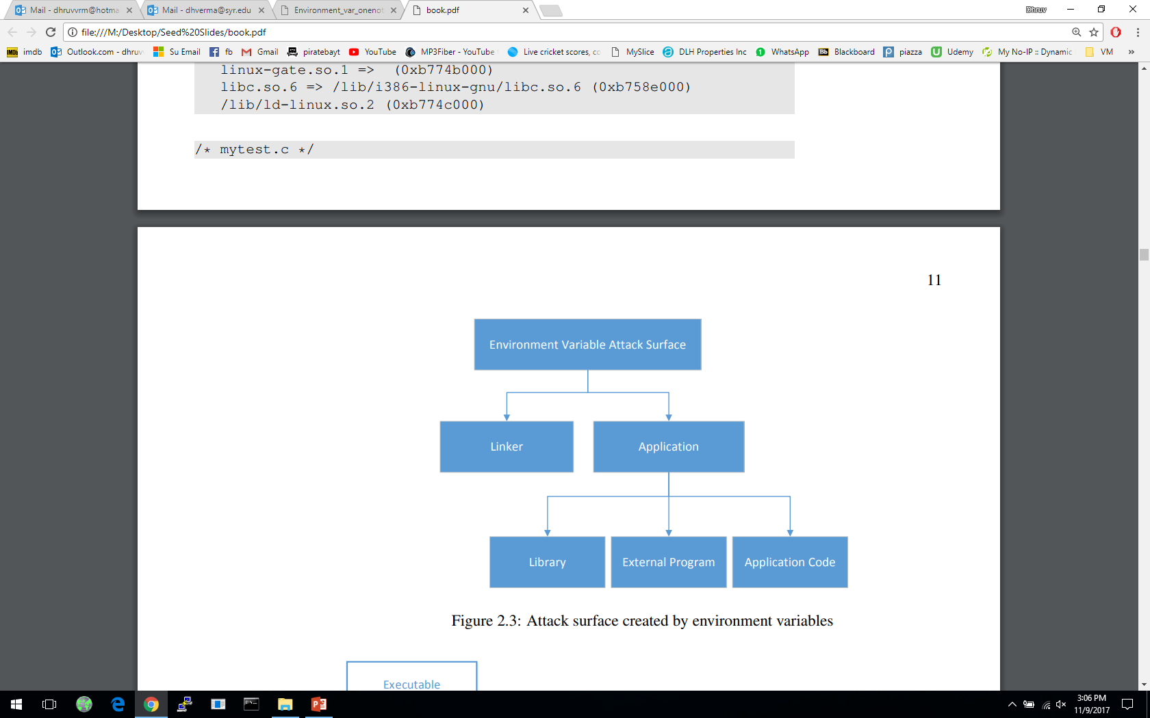
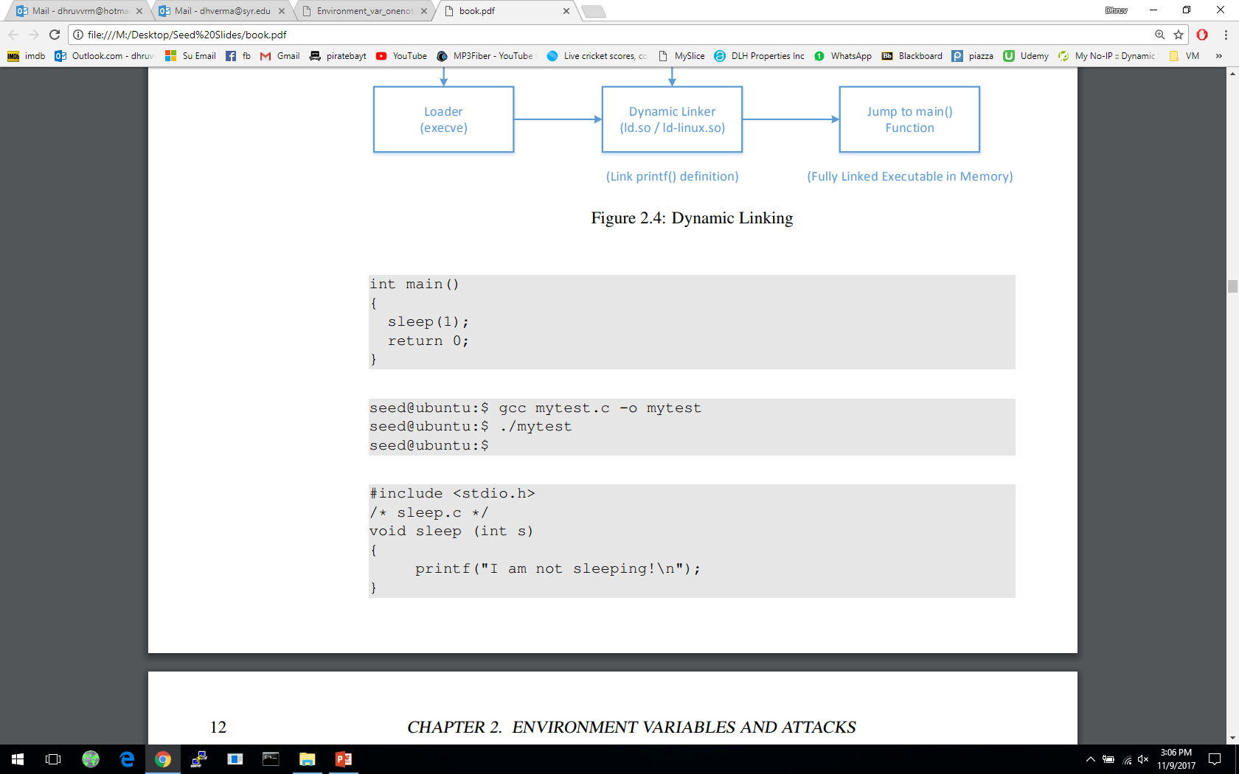
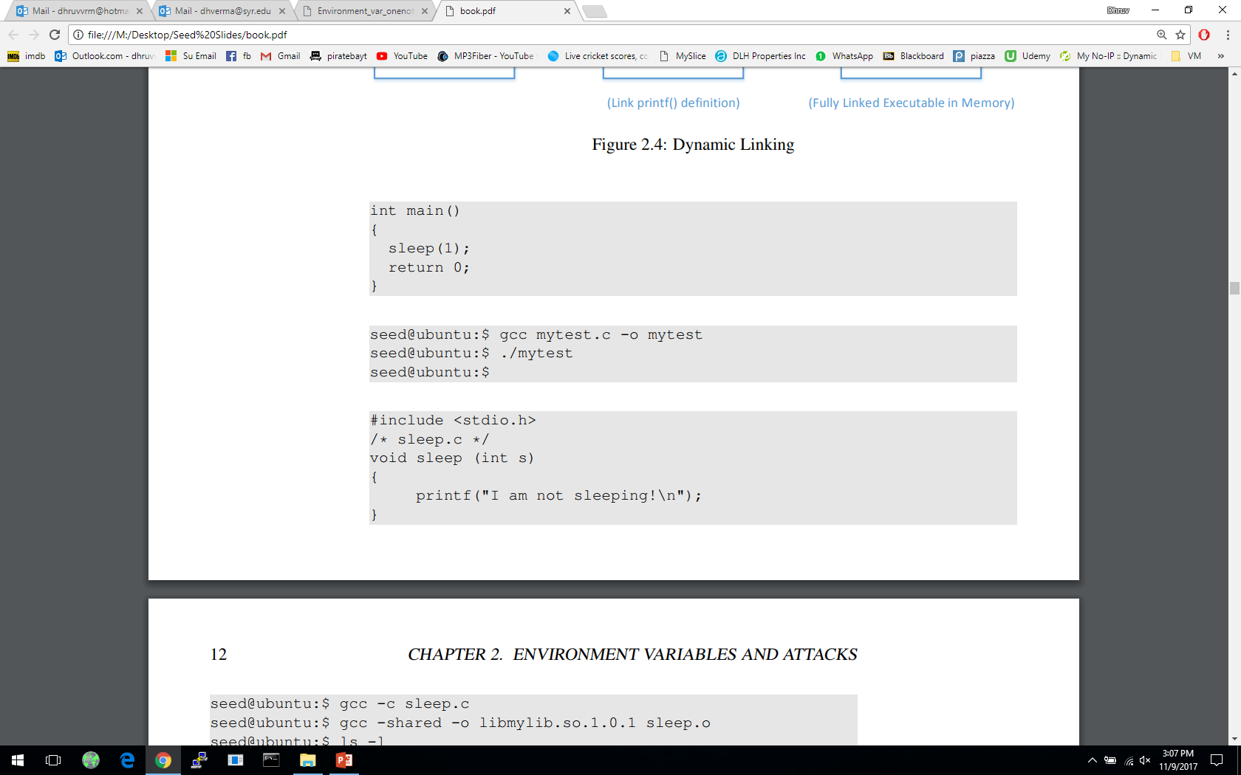
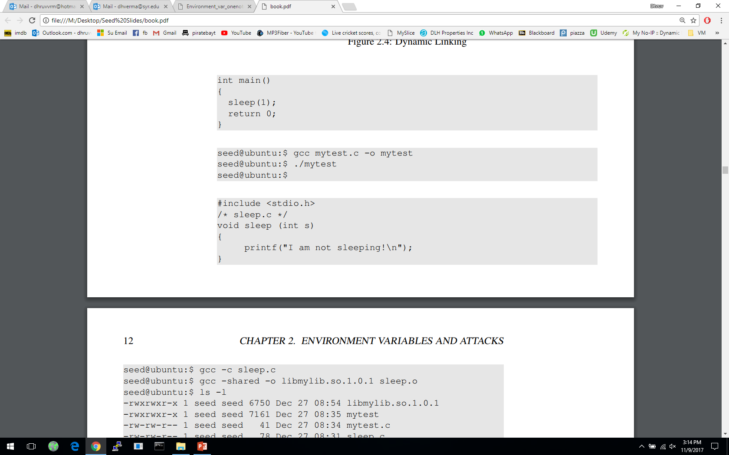
Attacks via Dynamic Linker: Case Study 1
Example 1 – Normal Programs:
Program calls sleep function which is dynamically linked:
Now we implement our own sleep() function:

Slide 36
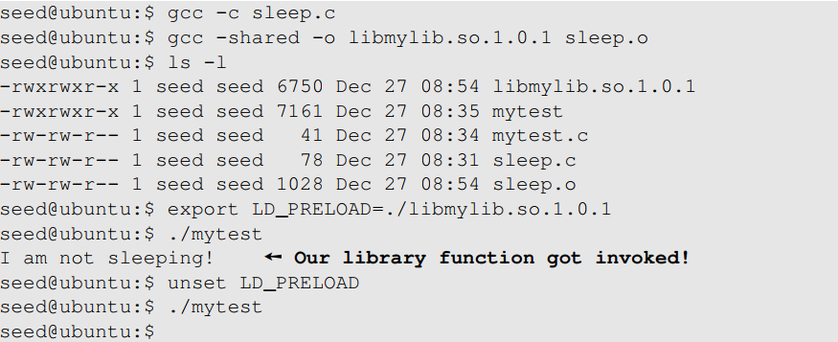
Attacks via Dynamic Linker: Case Study 1
Example 1 – Normal Programs (continued ):
We need to compile the above code, create a shared library and add the shared library to the LD_PRELOAD environment variable
Compile and run mytest
Set LD_PRELOAD with “export LD_PRELOAD=./libmylib.so.1.0.1”: it executes sleep() function defined in sleep.c
unset LD_PRELOAD: it executes the standard sleep() function
Notes:
LD_PRELOAD specifies a list of additional, user-specified, shared libraries to be loaded before all others
Compile mylib.c into a DLL named libmylib.so.1.0.1:
#include void sleep (int s) {
/* If this is invoked by a privileged program, you can do damages here! */
printf("I am not sleeping!\n"); }
Compile and run myprog
unset LD_PRELOAD: it executes the standard sleep() function
Set LD_PRELOAD with “export LD_PRELOAD=./libmylib.so.1.0.1”: it executes sleep() function defined in libmylib.so.1.0.1

Slide 37
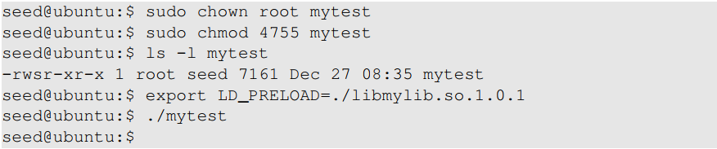
Attacks via Dynamic Linker: Case Study
Example 2 – Set-UID Programs:
If the technique in example 1 works for Set-UID program, it can be very dangerous. Lets convert the above program into Set-UID :
Our sleep() function was not invoked.
This is due to a countermeasure implemented by the dynamic linker. It ignores the LD_PRELOAD and LD_LIBRARY_PATH environment variables when the EUID and RUID differ.
Lets verify this countermeasure with an example in the next slide.

Slide 38
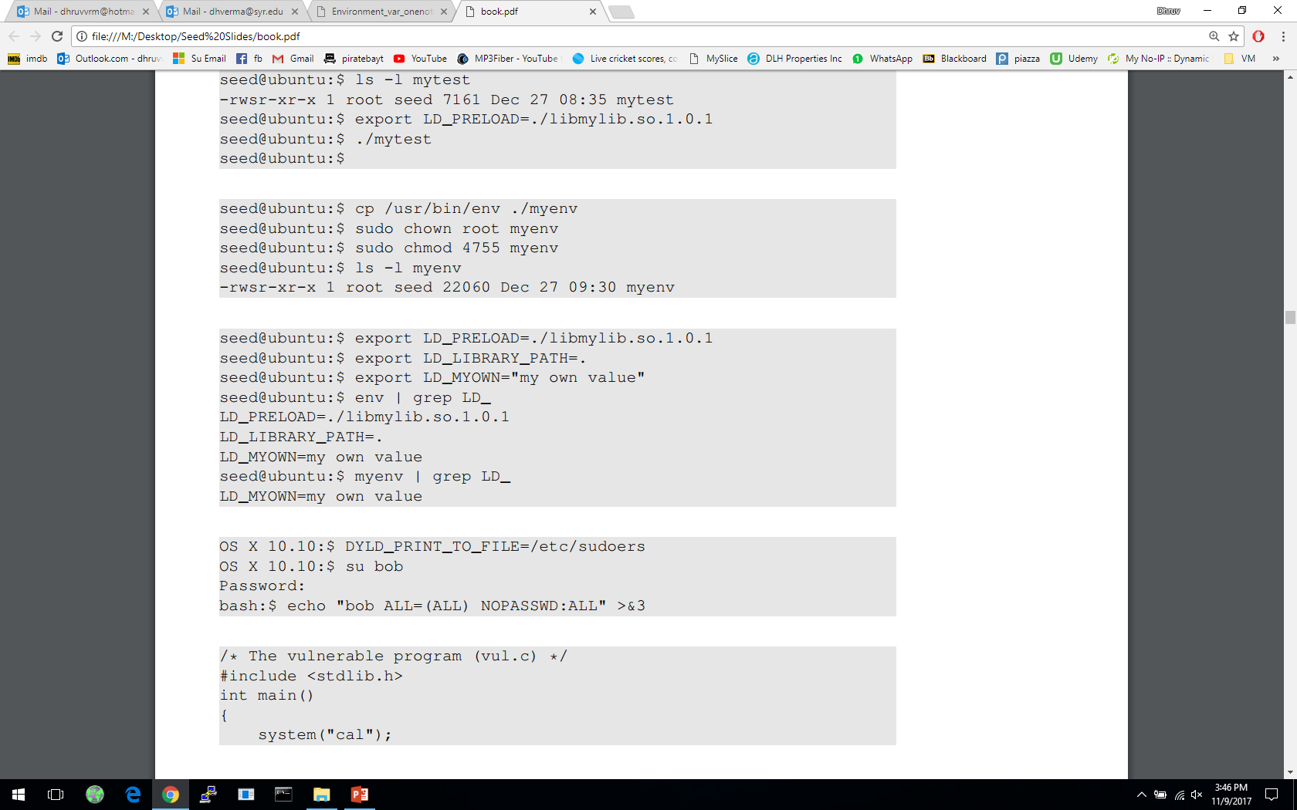

Attacks via Dynamic Linker
Let’s verify the countermeasure
Make a copy of the env program and make it a Set-UID program :
Export LD_LIBRARY_PATH and LD_PRELOAD and run both the programs:
Run the original env program
Run our env program
Notes:
Even though both the programs are identical, we see a difference.
myenv does not even display those two environment variables .
The LD_PRELOAD defined by us poses no threat. Task 7: The LD PRELOAD Environment Variable and Set-UID Programs

Slide 39
Attack Surfaces of Set-UID Programs
1. User inputs/External Programs
2. System inputs: race Conditions (e.g., with symbolic link to privileged file from an unprivileged file)
3. Environment variables
4. Non-privileged process controlled by user: capability leaking
Notes:
Influence programs
Writing inside world writable folder
System Inputs
Race Condition – More information in Chapter 7
Symbolic link to privileged file from a unprivileged file
Influence programs
Writing inside world writable folder
Carrying on from superman story, relate User inputs/External Programs: Explicit Inputs
Buffer Overflow – More information in Chapter 4
Overflowing a buffer to run malicious code
Format String Vulnerability – More information in Chapter 6
Changing program behavior using User inputs/External Programs as format strings
it to the attack surface on set-uid programs

Slide 40
Attacks via External Program
An application may invoke an external program.
The application itself may not use environment variables, but the invoked external program might.
Typical ways of invoking external programs:
exec() family of function which call execve(): runs the program directly
system()
The system() function calls /bin/sh
The shell program then runs the program
Attack surfaces differ for these two approaches
Attack:
Users are often asked to provide input data to the command.
If the command is not invoked properly, user’s input data may be turned into command name. This is dangerous.
Notes:
The attack surface expands for a privileged program when they invoke an external program execl()
execl()eventually calls execve()to run We have discussed attack surfaces for such shell programs in Chapter 1. Here we will focus on the Environment variables aspect.
Invoking external commands from inside a program
External command is chosen by the Set-UID program
Users are not supposed to provide the command (or it is not secure)

Slide 41
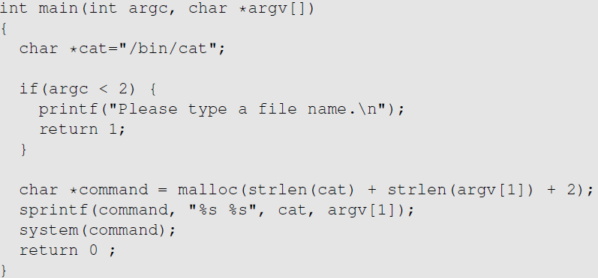
Task 8: Invoking External Programs Using system() vs. execve()
The easiest way to invoke an external command is the system() function.
With input “file1”, sprintf() generates a command “/bin/cat file1”, and system() runs it.
Compile this program into an executable “catall”. Set it to be a root-owned Set-UID program, so the program can view all files (with cat), but it can’t write to any file.
Question: Can you use this program to run other command, with the root privilege?

Slide 42
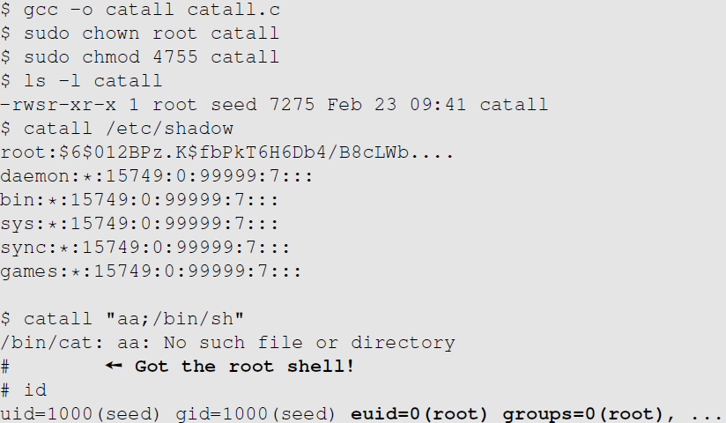
Invoking Programs : Unsafe Approach (Continued)
We can get a root shell with this input
Notes:
Run from normal user shell catall “aa; /bin/sh”
Both commands are run with root previliges due to Set-UID of catall_
/bin/cat aa
/bin/sh
Shell prompt # sign denotes root user by default
Run from normal user shell catall aa; /bin/sh
Both commands. First one runs with root due to Set-UID
Second one runs with normal user prevlisges.
/bin/cat aa
/bin/sh

Slide 43
Explanations for Previous Slide
User shell
catall
Run: catall “aa; /bin/sh”.
This line is split into 2 commands:
/bin/cat aa
/bin/sh
Both commands are run by catall, a root-owned Set-UID program, hence both commands are run with root privileges. cat command exists, but you get a root shell from /bin/sh (shell prompt # sign denotes root shell).
If you run: catall aa; /bin/sh.
This line is split into 2 commands:
/bin/cat aa (this is run by catall, a Set-UID program, hence it is run with root privileges)
/bin/sh (this is run by user’s normal shell, not a Set-UID program, hence it starts a new shell with user privileges)
aa
/bin/sh
catall “aa; /bin/sh”
User shell
catall
aa
/bin/sh
catall aa; /bin/sh

Slide 44
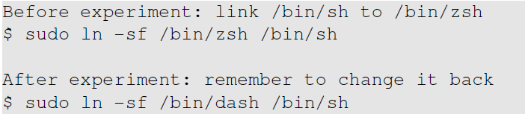
Circumventing the countermeasure by dash shell
In both Ubuntu 12.04 and Ubuntu 16.04, /bin/sh is actually a symbolic link pointing to the /bin/dash shell.
In Ubuntu 16.04, if dash detects that it is executed in a Set-UID process, it immediately changes the effective user ID to the process’s real user ID, essentially dropping the privilege.
Do the following to remove the countermeasure
Notes:
To see how our attack works without such a countermeasure, we will link /bin/sh to another shell:
$ sudo rm /bin/sh $ sudo
ln -s /bin/zsh /bin/sh
In Ubuntu 16.04, /bin/sh points to /bin/dash, which has a countermeasure
It drops privilege when it is executed inside a set-uid process
Therefore, we will only get a normal shell in the attack on the previous slide

Slide 45
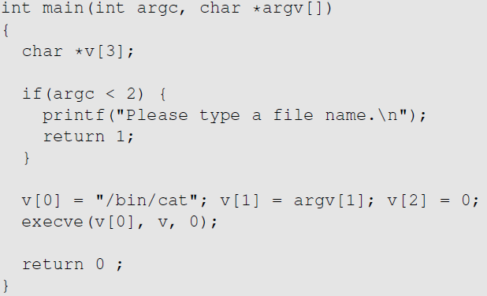
Invoking Programs Safely: using execve()
execve(v[0], v, 0)
Command name is provided here (by the program)
Input data are provided here (can be by user)
system() relies on /bin/sh to run external programs, so some part of the data becomes code (command name), increasing the attack surface.
int execve(const char *pathname, char *const argv[], char *const envp[])
1st argument is command; 2nd argument is input arguments; 3rd argument is env variables
execve() does not invoke shell, and thus is not affected by environment variables
Code (command name) and data are clearly separated; there is no way for user data to become code. When invoking external programs in privileged programs, we should use execve().
Notes:
int execve(const char *pathname, char *const argv[], char *const envp[])
Does not use /bin/sh, and run external programs directly.
1st argument is command; 2nd argument is input arguments; 3rd argument is env variables
Code (external program) and data are cleanly separated, hence running execve() is a secure method to invoke external programs.
Compared to system(), execve()’s attack surface is smaller
execve() does not invoke shell, and thus is not affected by environment variables
Why is it safe?

Slide 46
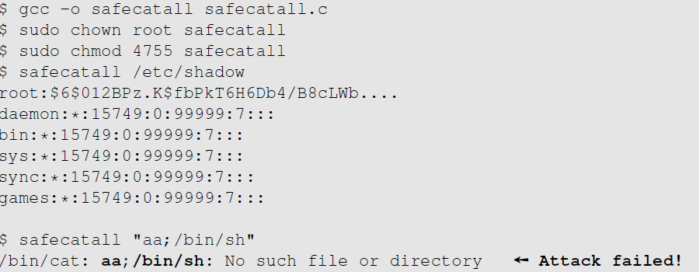
Invoking Programs Safely (Continued)
Using execve(), command safecatall “aa; /bin/sh” treats the entire string “aa; /bin/sh” as argument, and returns error msg “no such file or directory”.
The data is still treated as data, not code.
Notes:
The data are still treated as data, not code
Some functions in the exec() family behave similarly to execve(), but may not be safe
execlp(), execvp() and execvpe() duplicate the actions of the shell. These functions can be attacked using the PATH Environment Variable

Slide 47
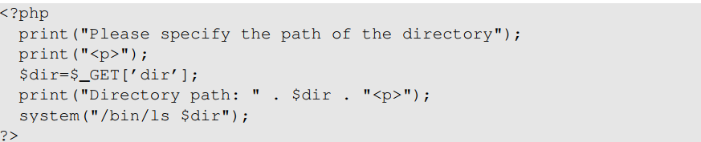
Invoking External Commands in Other Languages
Risk of invoking external commands is not limited to C programs
We should avoid problems similar to those caused by the system() functions
Examples:
Perl: open() function can run commands, but it does so through a shell
PHP: system() function
Attack:
http://localhost/list.php?dir=.;date
Command executed on server : “/bin/ls .;date”

Slide 48
Attack Surfaces of Set-UID Programs
1. User inputs/External Programs
2. System inputs: race Conditions (e.g., with symbolic link to privileged file from an unprivileged file)
3. Environment variables
4. Non-privileged process controlled by user: capability leaking
Notes:
Influence programs
Writing inside world writable folder
System Inputs
Race Condition – More information in Chapter 7
Symbolic link to privileged file from a unprivileged file
Influence programs
Writing inside world writable folder
Carrying on from superman story, relate User inputs/External Programs: Explicit Inputs
Buffer Overflow – More information in Chapter 4
Overflowing a buffer to run malicious code
Format String Vulnerability – More information in Chapter 6
Changing program behavior using User inputs/External Programs as format strings
it to the attack surface on set-uid programs

Slide 49
Task 9: Capability Leaking
To follow the Principle of Least Privilege, Privileged programs downgrade themselves during execution
Example: The su program
This is a privileged Set-UID program
Allows one user to switch to another user ( say user1 to user2 )
Program starts with EUID as root and RUID as user1
After password verification, both EUID and RUID become user2’s (via privilege downgrading)
Such programs may lead to capability leaking
Programs may not clean up privileged capabilities before downgrading

Slide 50
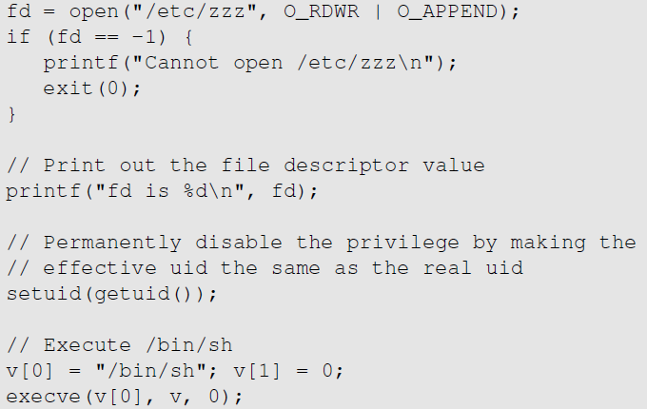
Attacks via Capability Leaking: An Example
/etc/zzz file is only writable by root
File descriptor fd is created, since the program is a root-owned Set-UID program)
Privilege is downgraded by setting EUID=RUID, no longer root
Start a shell as child process with normal user privileges; fd is passed to it automatically (otherwise the original program will finish, and fd will be closed automatically)
Notes:
so the behavior restriction on the program is lifted

Slide 51
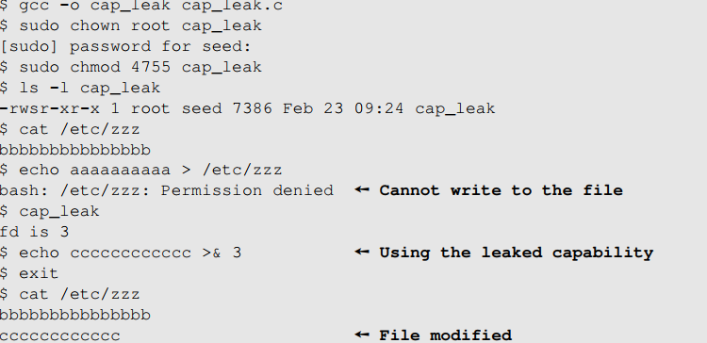
Attacks via Capability Leaking (Continued)
The program forgets to close the file, so the file descriptor fd is still valid in the new shell /bin/sh.
“echo string >& 3” writes string to file descriptor 3 successfully.
echo is not a Set-UID program, hence it is run with user privileges; yet it can write to fd due to leaked capability from calling open() by a Set-UID program.
How to fix the program?
Close the file descriptor fd before downgrading the privilege

Slide 52
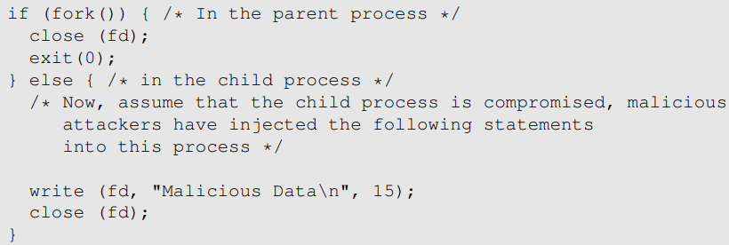
fork() is used instead of /bin/sh
In the program in your assignment, fd is passed to the child process created by fork() automatically.

Slide 53
Principle of Isolation
Principle: Don’t mix code and data.
Attacks due to violation of this principle :
system() code execution
Cross site scripting
SQL injection
Buffer overflow attacks

Slide 54
Principle of Least Privilege
A privileged program should be given the power which is required to perform it’s tasks.
Disable the privileges (temporarily or permanently) when a privileged program doesn’t need those.
In Linux, seteuid() and Set-UID() can be used to disable/discard privileges.
Different OSes have different ways to do that.

Slide 55
Set-UID Approach VS Service Approach
Most Oses follow two approaches to allow normal users to perform privileged operations
Set-UID approach: Normal users run a Set-UID program to gain root privileges temporarily
Service approach w. daemons (fig below): Normal users request a privileged process to perform the actions on their behalf.
Set-UID has a much broader attack surface, since environment variables are set by the normal user
Environment variables are never set by the user in the service approach
Due to this reason, Android completely removed the Set-UID and Set-GID mechanism
Request for service
Privileged Process
(Conduct privileged operations
for users)
Normal User Process
Notes:
From the functionality perspective, Set-UID performs better. This is because it does not require a running background process.
From the security perspective, Set-UID approach has a much broader attack surface
Describe part (a) of figure in previous slide – how environment variables come from a normal process and cannot be trusted
Describe part (b) of figure in previous slide – how service is started by a privileged parent process, so the environment variables comes from a trusted source. Although attackers can still attack using other attack surfaces, there is no way for them to do it using environment variables
Android which is built on top of Linux removed the Set-UID and Set-GID mechanism
Although, the other attack surfaces still apply to Service approach (Discussed in Chapter 1), it is considered safer than Set-UID approach

Slide 56
Summary
The need for privileged programs
How the Set-UID mechanism works
Security flaws in privileged Set-UID programs
Attack surface
How to improve the security of privileged programs

